Slide 1

Azure Project “Epimoni”
(Greek word for Perseverance)
By Sean Wadman

Slide 2
Project Overview
Description:
This project involves the creation and management of a secure, resilient, and scalable network infrastructure within Microsoft Azure. The foundation of this project is built on Azure’s robust networking capabilities, allowing seamless connectivity and management across services
Objectives:
To establish a highly available network infrastructure capable of supporting web applications, virtual machine scale sets (VMSS), and storage solutions
Implement Azure Bastion for secure, remote management of virtual machines
Ensure inter-region connectivity and security through VNet peering and network security groups (NSGs)
Scope of Project:
Initial Phase – Configuration of Virtual Networks (Vnets) across two primary regions: West US 2 and East US
Management Layer – Setup of Azure Bastion, providing secure and seamless RDP and SSH access to VMs without public IP addresses
Compute and Web – Deployment of VMSS for high availability and elasticity, alongside web apps for hosting dynamic web content
Storage – Integration of Azure storage solutions to ensure data persistence, redundancy, and recovery capabilities

Slide 3
Intro to Network Infrastructure Configuration
Key Components:
Virtual Networks (VNets)
Subnets in each VNet for different puposes
Customized address spaces to avoid overlap and facilitate peering
Establish local VNet peering in the East US region
Establish global VNet peering between East US and West US 2 regions
Configure Network Security Groups to secure and control access to subnets
Deployment Strategy:
ARM (Azure Resource Manager) templates for infrastructure-as-code approach, deployed using PowerShell, Azure CLI
Separate templates for network infrastructure and VNet peering to enhance manageability
Challenges and Solutions:
Address space overlap and peering configuration complexities, resolved through careful planning of address ranges and deployment sequence
(East US first, West US 2 second, Global Peering last)

Slide 4
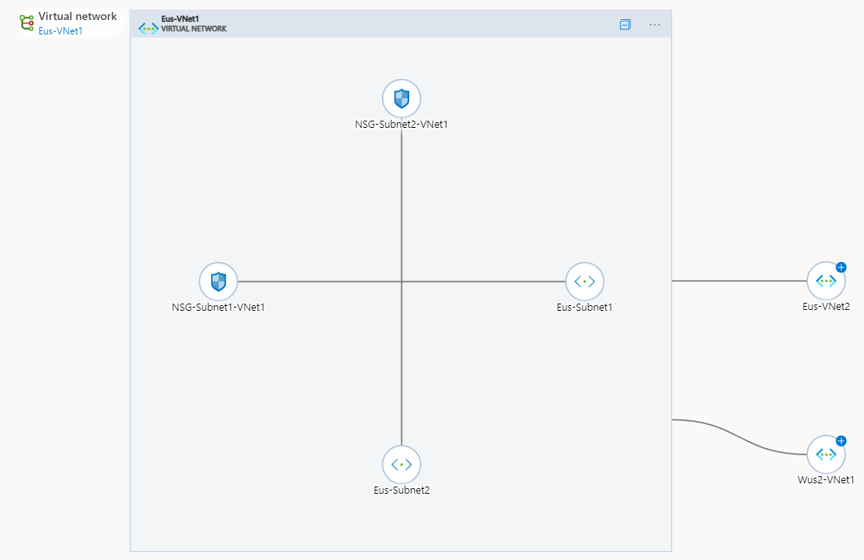
Eus-VNet1 Diagram

Slide 5
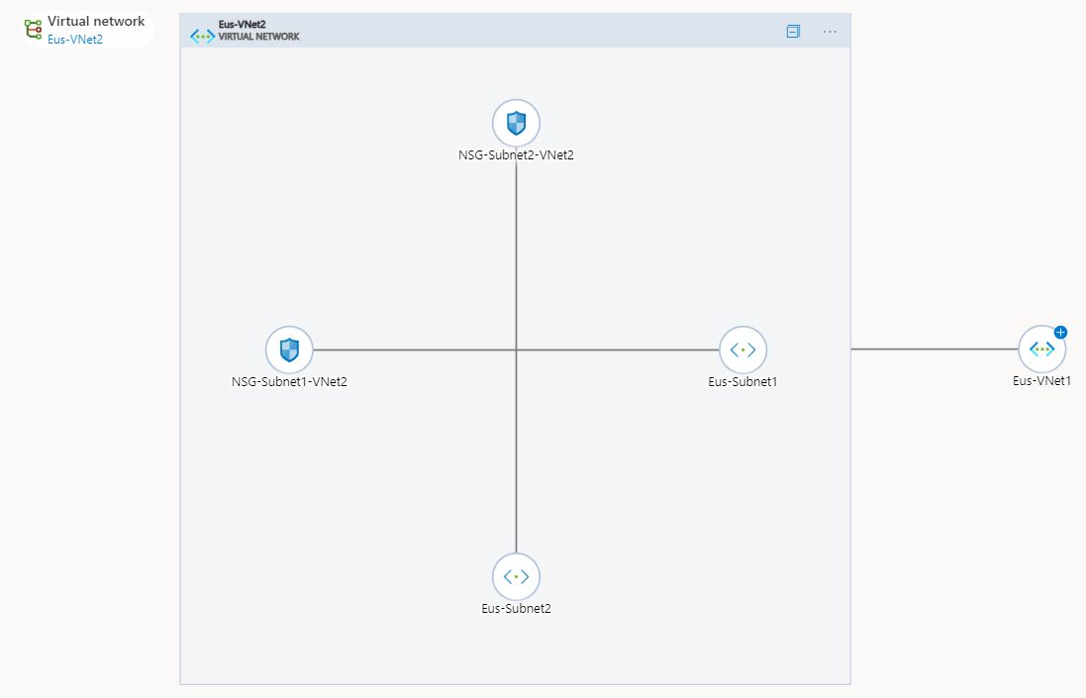
Eus-VNet2 Diagram

Slide 6
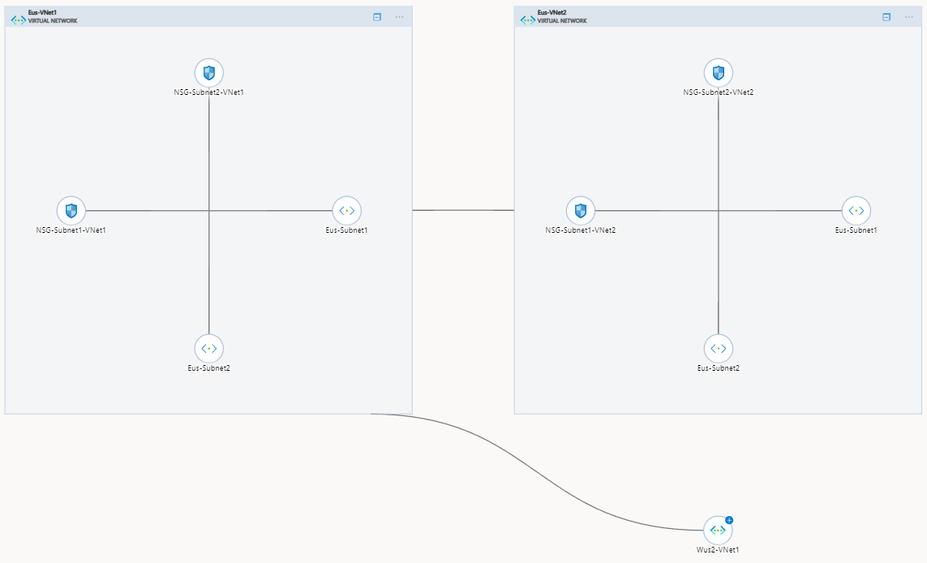
Local and Global Peering Diagram

Slide 7
Summary of Network Configuration
Create Azure Resource Groups using a Power Shell Script:
Epimoni-EastUS-Dev
Epimoni-EastUS-Prod
Epimoni-WestUS2-Dev
Epimoni-WestUS2-Prod
Create Azure Network Resources in East US region using a single JSON template and Parameters file:
Two Virtual Networks
Four Subnets, two in each Virtual Network
Four Network Security Groups (NSGs), each one associated with its own Subnet
Local VNet Peering established between Virtual Networks
Create Azure Network Resources in West US 2 region using a single JSON template and Parameters file:
One Virtual Network
Two Subnets
Two Network Security Groups (NSGs), each one associated with its own Subnet
Create Global VNet Peering using separate JSON templates and Parameters files:
First template initiates the global peering connection, second template completes the peering

